Slide 1
For Loop , While Loop & Nested Loop in Python.

Slide 2
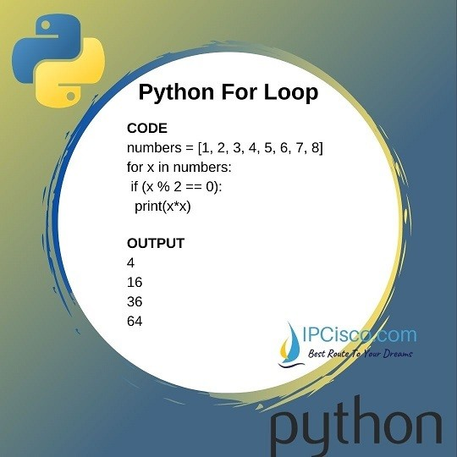
For Loop
A for loop is used for iterating over a sequence (that is either a list, a tuple, a dictionary, a set, or a string).
This is less like the for keyword in other programming languages, and works more like an iterator method as found in other object-orientated programming languages.
With the for loop we can execute a set of statements, once for each item in a list, tuple, set etc.

Slide 3
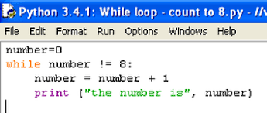
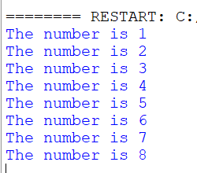
While Loop
With the while loop we can execute a set of statements as long as a condition is true.

Slide 4
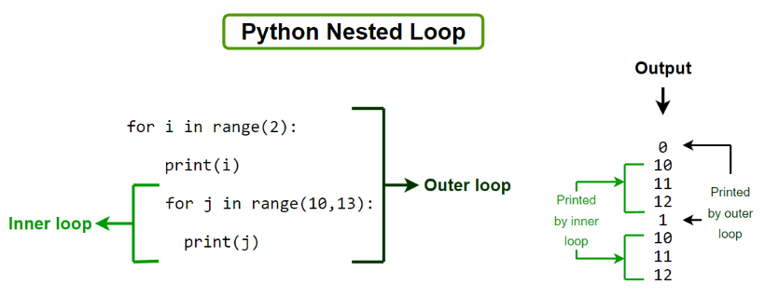
Nested Loop
In python programming language , there are two types of loops which are for loop and while loop. Using these loops we can create nested loops in Python. Nested loops mean loops inside a loop. For example, while loop inside the for loop, for loop inside the for loop, etc.

Slide 5
Thank You
07_Rabin_Nadar
S.Y.B.Sc.IT

